Slide 1
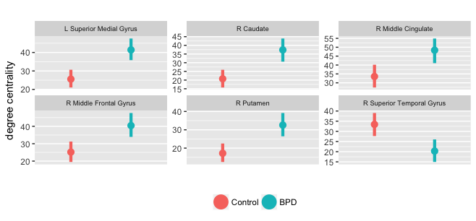
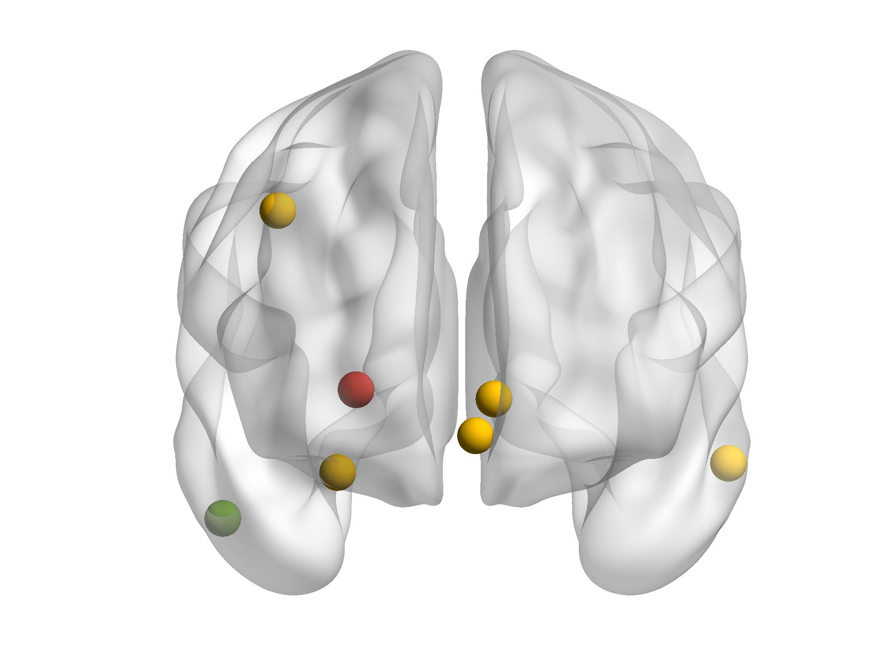
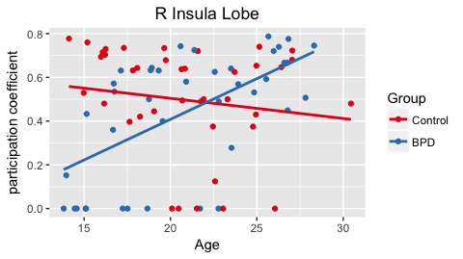
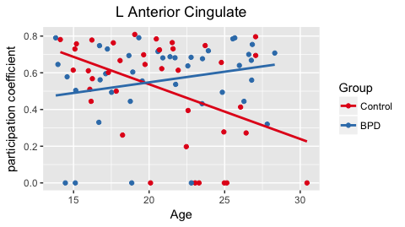
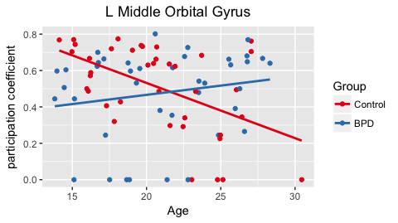
Developmental changes in resting-state functional connectivity in borderline personality disorder: a network analysis approach
Nathan T. Hall¹ and Michael N. Hallquist¹
¹ The Pennsylvania State University, Department of Psychology
Introduction
Borderline Personality Disorder (BPD) is a serious personality disorder characterized by instability in affect, interpersonal relationships, and identity, as well as high levels of impulsivity and aggression.
Past functional activation studies using fMRI studies have implicated the dlPFC, vmPFC, ACC, PCC/precuneus, Insular Cortex, and Amygdala as regions displaying functional abnormalities during emotion-regulation, social exchange, and impulse control tasks (Ruocco et al., 2013, King-Casas et al 2008, Soloff et al., 2015).
Resting-state functional connectivity
Recent advances in clinical neuroscience have included an integration of network analysis via graph theory to understand brain function both during task and at rest (Bullmore and Sporns, 2009).
Results have tended to converge around an increased level of intrinsic functional connectivity in the DMN and decreased connectivity in frontal executive control networks and midline hubs (ACC, PCC, mPFC) in patients with BPD compared to controls (Wolf et. al., 2011, Visintin et. al., 2016).
BPD develops in adolescence
Adolescence is a period of vulnerability for developing BPD and understanding how brain networks develop during this developmental window can help constrain our thinking about abnormal brain development in BPD.
No previous work has investigated the development of brain networks in BPD.
Method
Participants
79 participants matched on sex (55 females), age (13-28 years, M= 20.85), and BPD symptoms (n BPD = 40).
9 participants (6 BPD) were excluded for having a framewise displacement of .5mm or more on 15% or more volumes.
RS-fMRI data acquisition and analytic approach
We collected five minutes of resting-state fMRI data (TR = 1.0s, TE = 30ms, voxel size = 2.3mm isotropic) in a Siemens Tim Trio 3T scanner while subjects lay awake with eyes open.
Preprocessing in FSL 5.0 and nipy: slice timing and motion correction, wavelet despiking, nonlinear warp to MNI152, grand mean scaling, spatial smoothing (5mm), bandpass filtered .009-.08 Hz and nuisance regression (CSF + WM and their derivatives).
Resting-state network matrices were derived from temporal correlations among whole-brain regions defined by an established parcellation containing 264 regions (Power et al., 2011).
Graph theory analysis
Matrices were density thresholded at 1-20% and binarized for input to community detection algorithm (infomap, Bohlin, Edler, Lancichinetti, and Rosvall, 2014). Emphasis placed on group x age interactions in connectivity strength between networks via the participation coefficient:
Results
Significant BPD x Age interactions for PC were found in temporal and midline nodes in the DMN including the insula, middle cingulate, and middle orbital gyrus.
Group differences in nodal degree centrality. Networks were thresholded for graphical display at a density of 0.12, which is representative of connectivity patterns across densities
Discussion
Results indicate increases in between-network connectivity over time in individuals with BPD in nodes located within the DMN.
The DMN is known to be hyperactivated and hyperconnected in common mental disorders such as schizophrenia and depression (Whitfield-Gabrieli & Ford, 2011).
One interpretation of these findings is that functional segregation of DMN regions decreases throughout the transition to early adulthood, which has been hypothesized to be linked to social cognitive deficits in children with autism spectrum disorder (ASD) (Yerys et. al., 2015).
Increases in inter-modular connectivity in DMN regions has also been linked to difficulties in task switching.
Future directions include integration of clinical self-report measures (i.e. impulsivity, negative affect) and symptom severity and well as more nuanced edge difference comparisons such as the NBS (Zalesky et. al., 2010).
Poster presented at The American Psychopathological Association, New York, NY, 2017.
Please direct any questions or comments on this poster to nth7@psu.edu

